Slide 1

Generative Models

Slide 2
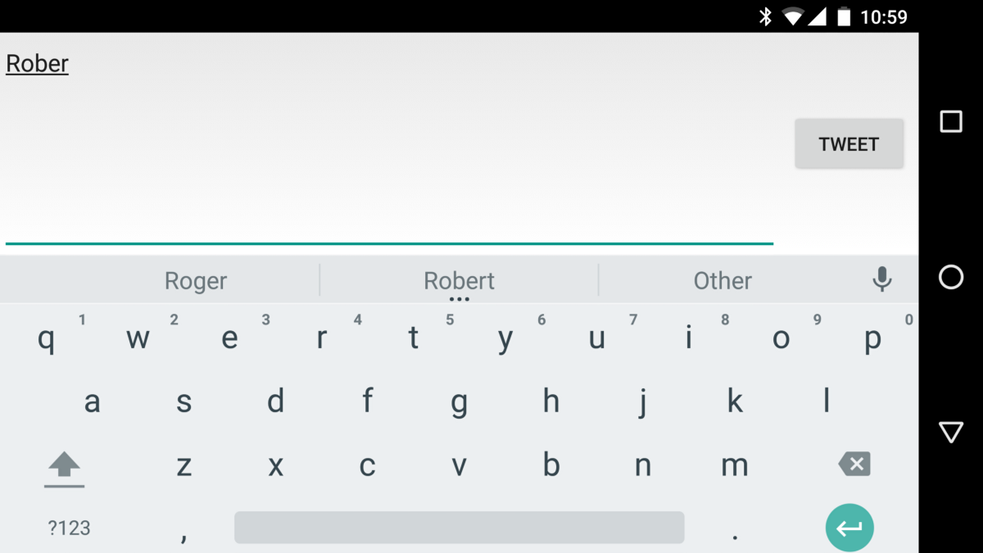
How to predict next word(s) as we type in keyboard?

Slide 3

Search suggestions

Slide 4
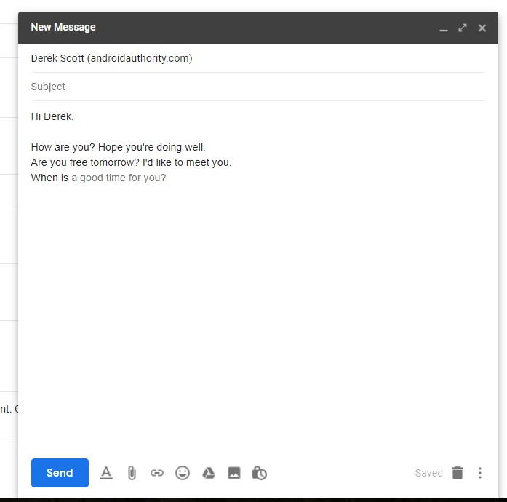
Completing Email Response

Slide 5
Language Models
Predicting probability of next data element e.g word, character given a sequence

Slide 6
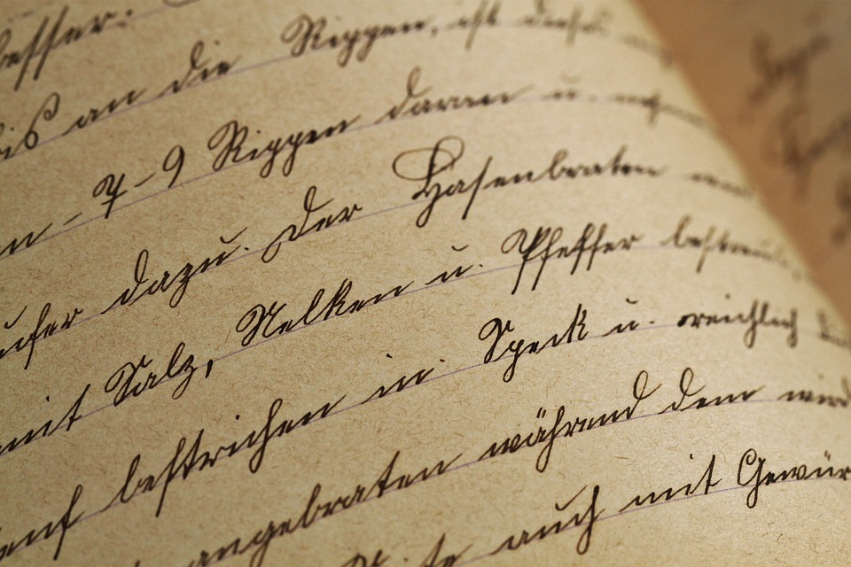
Building
Char RNN

Slide 7
Char RNN
Ask model to predict next character
E
LSTM
LSTM
LSTM
LSTM
LSTM
LSTM
M
A
C
H
I
N
We feed several characters as input (one char at a time) ...

Slide 8

Where would we get the training data for building Char-RNN?
… may be a book or any other meaningful text

Slide 9
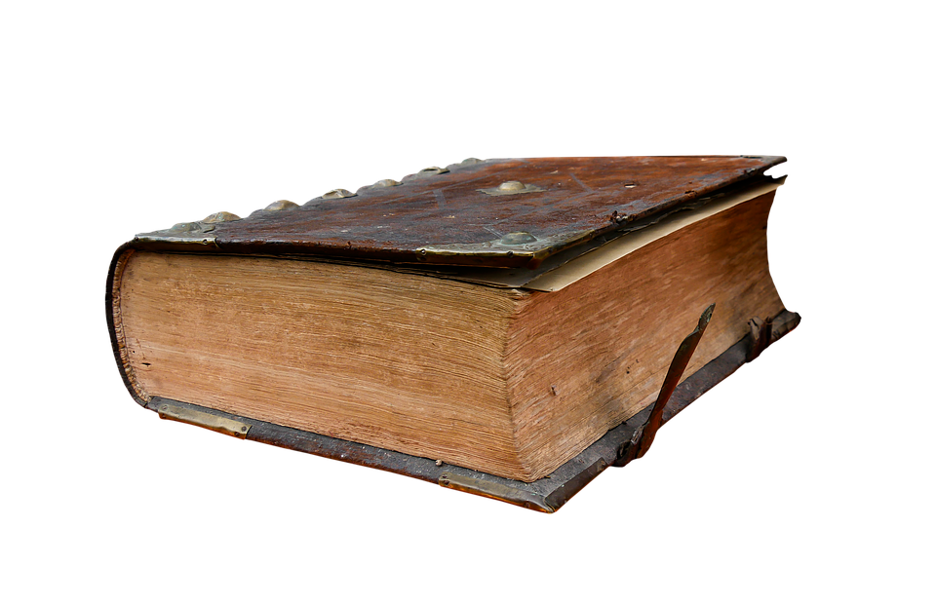
Deep Learning with Python introduces the field of deep learning using the Python language and the powerful Keras library...
Input

Slide 10
To train this model, what will be …
Input features (X)
Actual labels (y)

Slide 11
Preparing x and y for Char-RNN
Let’s assume next Character depends on last 5 chars
Record# | Input Sequence (x) | Label (Y)
1 | D, e, e, p, ‘ ‘ | L
2 | e, e, p, ‘ ‘, L | e
3 | e, p, ‘ ‘, L, e | a
4 | p, ‘ ‘, L, e, a | r
5 | ‘ ‘, L, e, a, r | i
Deep Learning with Python introduces the field of deep learning using the Python language and the powerful Keras library...
Once we have the input sequence and actual label, it becomes fairly straightforward to model the data using LSTM.

Slide 12
What Vectorization scheme can we use?
Book data
Deep Learning with Python introduces the field of deep learning using the Python language and the powerful Keras library...
Tokenize
1. Break text into chars
2. Find unique chars
3. Assign index to each char
Prepare
1. Decide sequence length e.g 5
2. Build input features (X)
3. Build actual Labels (y)
Vectorize
Data Pre-Processing
Char-RNN

Slide 13
As unique characters are usually a small number, we can use One hot encoding!
Book data
Deep Learning with Python introduces the field of deep learning using the Python language and the powerful Keras library...
Tokenize
1. Break text into chars
2. Find unique chars
3. Assign index to each char
Prepare
1. Decide sequence length e.g 5
2. Build input features (X)
3. Build actual Labels (y)
Vectorize
Data Pre-Processing
Char-RNN

Slide 14
Model Building
Char RNN
Characters sequence
For example,
1. 5 chars in each sequence
2. Each char using one hot encoding (vocab size = 100)
What will be the next layer?
[5,100] numbers for each sequence

Slide 15
Model Building
Char RNN
Characters sequence
For example,
1. 5 chars in each sequence
2. Each char using one hot encoding (vocab size = 100)
LSTM Layer
Build understanding of the character sequence
What will be the output?
[5,100] numbers for each sequence

Slide 16
Model Building
Char RNN
Characters sequence
For example,
1. 5 chars in each sequence
2. Each char using one hot encoding (vocab size = 100)
LSTM Layer
Build understanding of the character sequence
Memory Size = 200
LSTM Memory
(which has knowledge of sequence)
[5,100] numbers for each sequence
200 numbers for each sequence
What will be next layer?

Slide 17
Model Building
Char RNN
Characters sequence
For example,
1. 5 chars in each sequence
2. Each char using one hot encoding (vocab size = 100)
LSTM Layer
Build understanding of the character sequence
Memory Size = 200
Output Layer
(Dense Layer)
[5,100] numbers for each sequence
200 numbers for each sequence
How many outputs do we need?

Slide 18
Model Building
Char RNN
Characters sequence
For example,
1. 5 chars in each sequence
2. Each char using one hot encoding (vocab size = 100)
LSTM Layer
Build understanding of the character sequence
Memory Size = 200
Output Layer
(Dense Layer)
# Neurons = # Unique chars
Softmax
Probability for each character to be next character
[5,100] numbers for each sequence
200 numbers for each sequence
100 probabilities
(= unique chars count)
What should we do next?

Slide 19
Model Building
Char RNN
Characters sequence
For example,
1. 5 chars in each sequence
2. Each char using one hot encoding (vocab size = 100)
LSTM Layer
Build understanding of the character sequence
Memory Size = 200
Output Layer
(Dense Layer)
# Neurons = # Unique chars
Softmax
Calculate Loss
Gradient Descent
[5,100] numbers for each sequence
200 numbers for each sequence
100 probabilities
(= unique chars count)
Update weights

Slide 20
Memory for One Hot Encoding ...
~28 GB

Slide 21
Do we need to feed all the data at Once?
No
We need only one Batch in Memory

Slide 22
Batch Size | 64
Size of Each Record | 100 Chars
Size of each Char | 87 (One Hot Encoding)
Number of Bytes / Integer | 4
Memory required for a Batch (for One Hot step) | 64*100*87 * 4 ~2.2M
Memory Required for generating ALL data at Once | ~28GB (more than 10,000 times than single batch)

Slide 23

Code Exercise

Slide 24
Using model for Prediction … during training?

Slide 25
How to check model’s output during training?
Keras callbacks
keras.io

